Slide 1
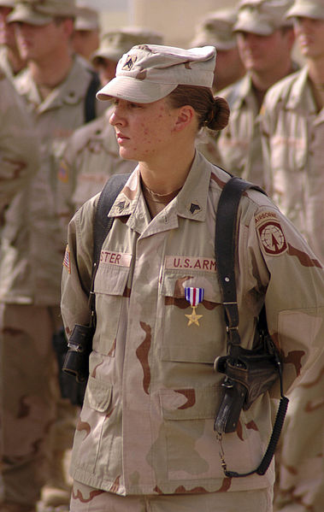
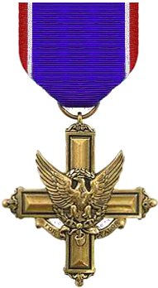
Sgt Leigh Ann Hester
Hester's squad was shadowing a 30-truck supply convoy when it was attacked in Salman Pak, Iraq. Hester maneuvered her team through the kill zone and into a flanking position while taking fire from AK-47 assault rifles, RPK machine guns and rocket propelled grenades (RPG). Sgt Hester and another sergeant then assaulted and cleared two a trench lines which insurgents were using as cover. During the 25-minute firefight, the team was credited with 27 insurgents killed, six insurgents wounded, and one captured. Sgt Hester, Sgt Nein, and Spc Mike (combat medic) were awarded Silver Stars for their valor.
Sgt Hester’s Silver Star was later upgraded to the Distinguished Service Cross, second only to the Medal of Honor.

